Slide 1

AI Generative web App
A Web App with multiple Ai generative Features

Slide 2

Raj Kumar Goel Institute of Technology Ghaziabad
5th KM. STONE, DELHI-MEERUT ROAD, GHAZIABAD (U.P)-201003.
Department of Computer Science Engineering & Engineering
Final Year Project Approval Presentation
on AI Generative web App
(A.I Generator Web Application based on OpenAi)
STUDENTS: Under the Guidance of
SR.NO. NAME ROLL No. 1. Dr. Gaganjot kaur(Coordinator)
1 HARSH SAHU 2100330109005 2. Mr. RAMVEER SINGH
2 ALOK KUMAR 2000330100040 3. Mr. SHAKIL AHMAD
3 ANMOL JAIN 2000330100048 4. Ms. AYUSHI TYAGI
4 ARYAN YADAV 2000330100063 Department Of CSE

Slide 3
CONTENTS
INTRODUCTION
OBJECTIVE
METHODOLOGY
Requirement Specification and Analysis
DFD /ER Diagram/ wireframe/Application Architecture
Project Modules Design/ Database tables/ Software Features
Project Snapshots
Limitations
Future Scope
Conclusion
References

Slide 4
Our Idea
The Idea behind this project is Latest trending technologies. Like OpenAi make big changes in Web Apllication.
That’s why we think about this Project.

Slide 5

01
About the Project
Ai generative Web Application.

Slide 6
What We Are Working On
Added Authentiction
Ai web app
Using OpenAI
AI web application which generates multiple thing on same plateform.
To implement these features we use Trending and latest OpenAi API for different Module
In this App we will implement Authentication with Gmail, Google and multiple Social media

Slide 7
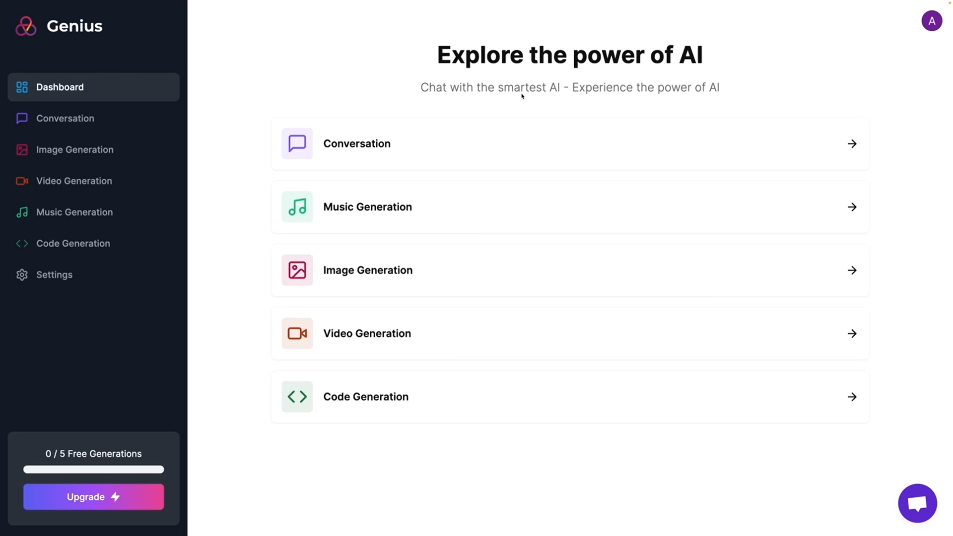
About the Project
The AI Generative Platform is a cutting-edge web application that utilizes artificial intelligence algorithms to generate creative outputs across various domains. It empowers users to effortlessly create unique and diverse content, including images, code, music, videos, and conversations. With its intuitive interface and powerful AI models, the platform opens up new avenues for creativity and innovation.

Slide 8



Major Requirements
Next.js
React
API
Using OpenAi Api for multiple module.
For building server rendered react Application. Also can handle Client site.
Its role to creating dynamic user Interface and user Interaction
This Photo by Unknown Author is licensed under CC BY-NC-ND
This Photo by Unknown Author is licensed under CC BY-NC
This Photo by Unknown Author is licensed under CC BY-SA

Slide 9
Tech Stack
Next.js13
React
Project tech uses
Tailwind
Stripe
Prisma

Slide 10
Project Goals
GOAL 1
GOAL 2
GOAL 3
Content Generation
Excellence:-This content should be creative, useful, and customizable to meet the needs of various users.
User-Friendly Experience:- A key focus is on an aesthetically pleasing and easy-to-navigate interface.
Innovation and Creativity:-Promote innovation in content generation and encourage users to think creatively

Slide 11

How It Works
User input: Every component work on User input.Only user required to give description about the requirement.
AI processing: After taking Input from user it will provide result as user input.
Output and customization options: we can customize or regenerate the result by application and can be downloaded.

Slide 12
Project Stages
Ui Developent
Complete Responsive Interface
Adding Api of different Module and connect to their pages
Adding Authentication login /SignUp
Stage 1
Stage 2
Stage 3
Error handling and writing some test cases
Pro model Ui
With Stripe Integration
Wrapping up With deployment of Project
Stage 6
Stage 5
Stage 4

Slide 13
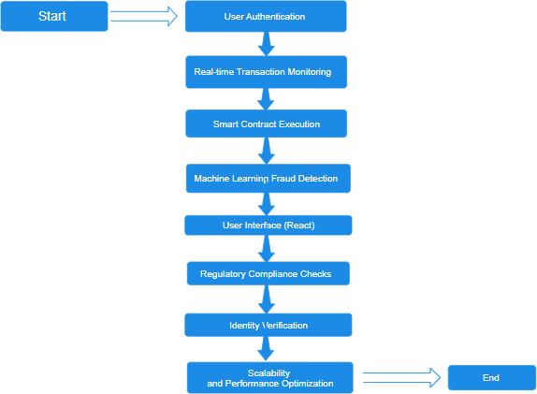
DATA FLOW DIAGRAM

Slide 14
PROJECT SNAPSHOT

Slide 15
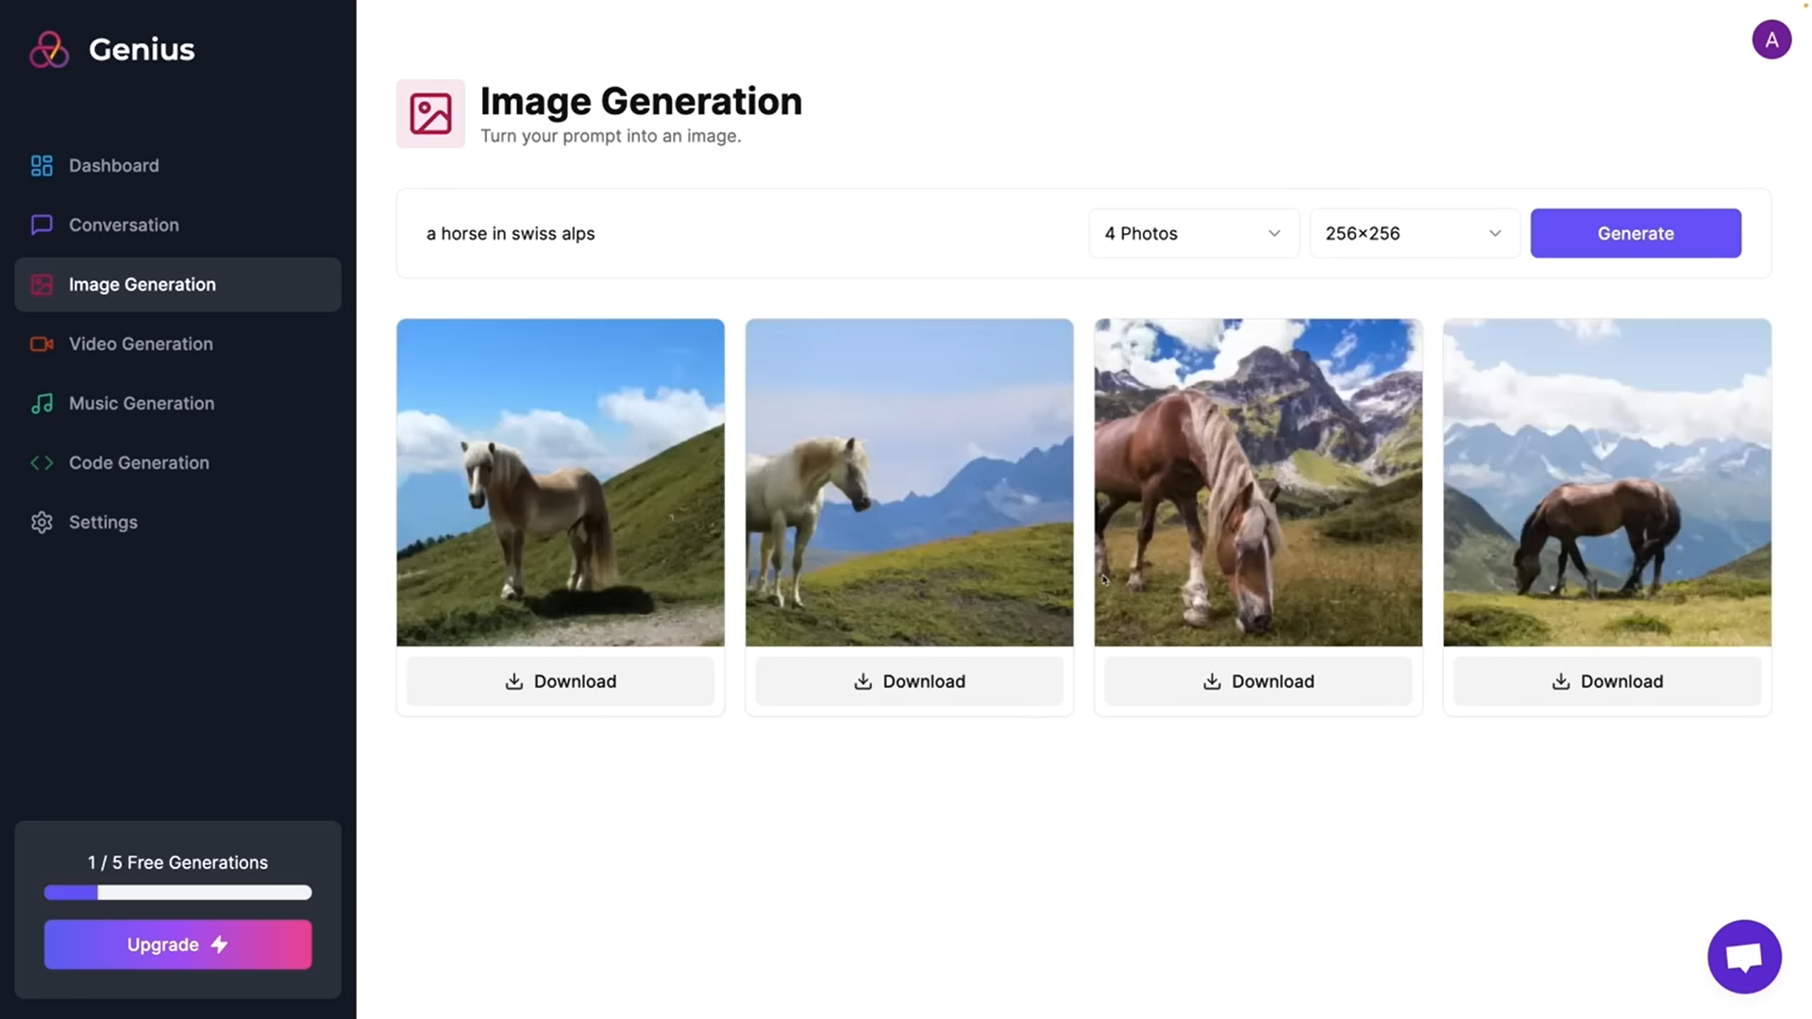

Slide 16
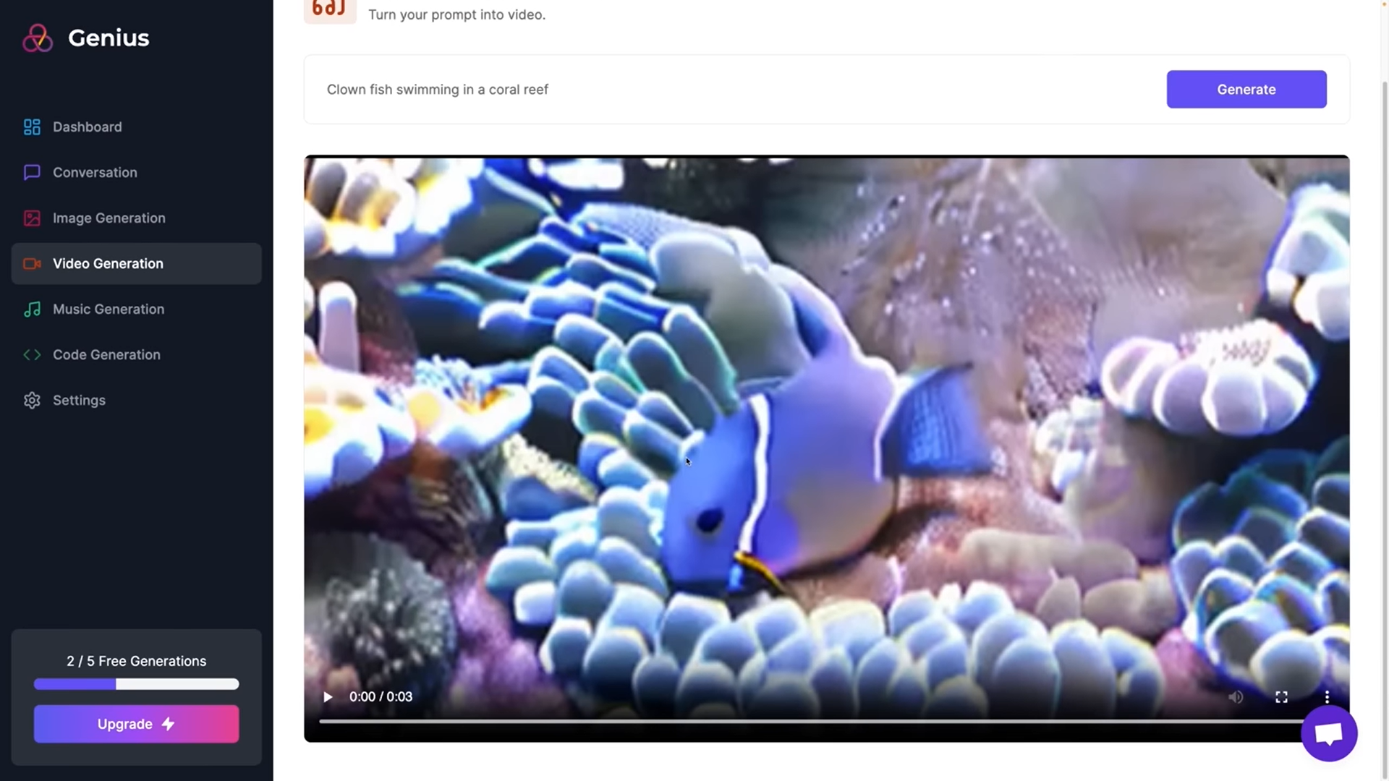

Slide 17
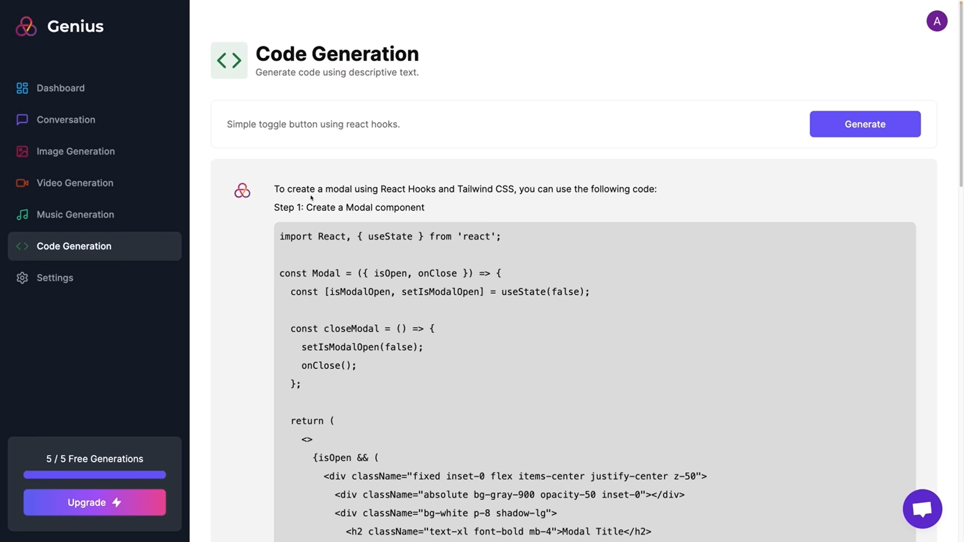

Slide 18
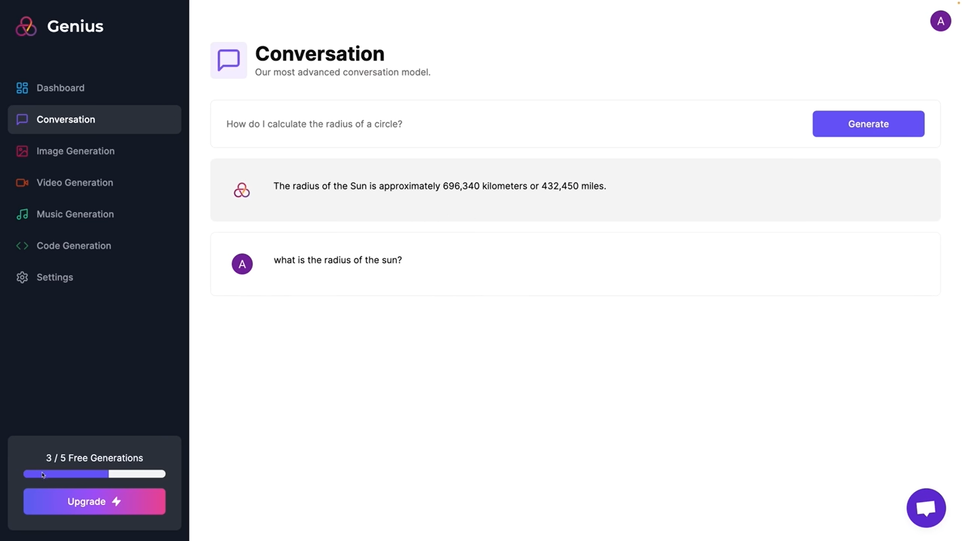

Slide 19
LIMITATION OF PROJECT
1. Quality and Creativity Constraints
While AI can produce music, conversation, video, code, and images, the quality and creativity often fall short of human standards. AI-generated content may lack the depth, emotion, and originality that human creators can achieve.
2. Lack of Context Understanding:
AI algorithms may struggle to understand the context in which they are generating content. This can lead to inaccuracies, misinterpretations, or inappropriate outputs, especially in conversation and image generation.
3.Dependency on Training Data:
AI models require large amounts of data to learn and generate content. If the training data is biased, incomplete, or unrepresentative, it can lead to biased or inaccurate outputs.

Slide 20
FUTURE SCOPE
1.Enhanced Quality and Creativity: Future AI models may exhibit improved capabilities in producing high-quality, creative content that rivals or even surpasses human standards. This could involve advancements in generative algorithms, reinforcement learning, and hybrid human-AI collaboration approaches.
2.Context-Aware Generation: AI models will likely become more adept at understanding context, enabling them to generate content that is more relevant, accurate, and personalized to the user's needs. This could involve incorporating contextual information from various sources, such as user preferences, historical data, and real-time feedback.
3.Ethical and Responsible AI: There will be a growing emphasis on developing AI systems that prioritize ethical considerations, transparency, and accountability. This includes mitigating bias, ensuring fairness, and implementing safeguards against misuse, particularly in sensitive domains like deepfake detection and content moderation.

Slide 21
Project major Components
Code Generation.
Experience the future of development as our website generates intelligent code tailored to your specific needs.
Image generation-Discover the incredible potential of Open AI for image generation. Bring your ideas to life with AI-assisted visual creativity
01
02
03
04
Converstion-
Break the barriers of communication using Open AI. Generate dynamic and engaging conversations that captivate your audience
Video Generation-Immerse your audience in captivating visuals created with Replicate AI. Harness the power of AI to produce stunning and engaging videos.

Slide 22
CONCLUSION
The development of the AI Generative Web Application represents a significant milestone in addressing the challenges and opportunities in content creation, personalization, and user engagement on the web. Through the utilization of cutting-edge AI algorithms, we have demonstrated the capability to generate diverse forms of content, including text, images, videos, and music, tailored to the preferences and needs of individual users.
Throughout the project, we encountered several key challenges, including ensuring the quality and diversity of AI-generated content, understanding user context for personalized recommendations, and addressing ethical considerations such as bias and privacy. However, through iterative development, rigorous testing, and collaboration with domain experts, we have successfully navigated these challenges to deliver a robust and scalable web application.
In conclusion, the AI Generative Web Application represents a transformative tool for content creators, businesses, and users alike, driving forward the frontier of AI-driven innovation on the web. Through ongoing collaboration, research, and responsible deployment, we are confident that our application will continue to inspire, engage, and delight users in the digital age.

Slide 23
Our Team
Harsh Sahu
Anmol Jain
Roll no. 2100330109005
Roll no. 2000330100048
Alok kumar
Aryan Yadav
Roll no. 2000330100040
Roll no. 2000330100048

Slide 24
—Akshay saini
“Take risk & succeed, people wil call you Lucky.
Take Risk & fail, people will call you a fool”

Slide 25


Thanks!
.
This Photo by Unknown Author is licensed under CC BY-SA-NC

